Slide 1

Udacity User Behavior
Alvaro Hu

Slide 2
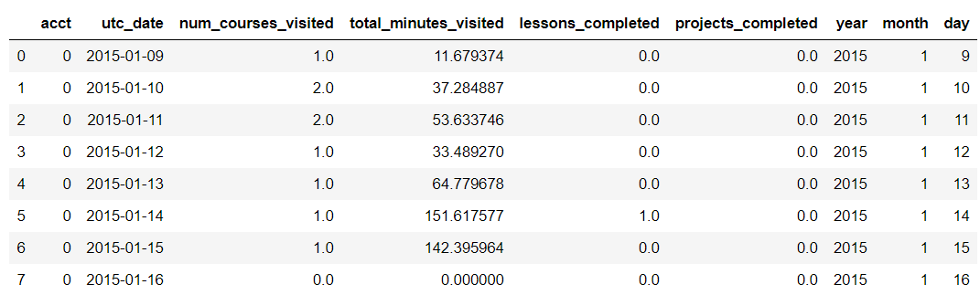
The Data
136,000 Rows
1,237 Unique accts

Slide 3
The Question
What can we do to keep people on Udacity?
Anything in their first two weeks?

Slide 4

Exploring the Data
We must know the data to tell its story

Slide 5
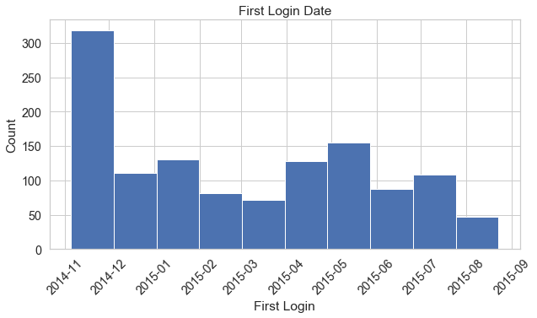
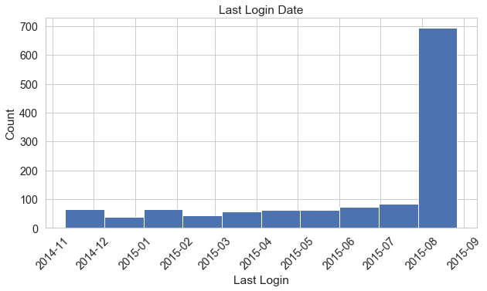
Partial Data
Some assumptions and drops will have to be made for further analysis
Not given a “sign-up” date

Slide 6
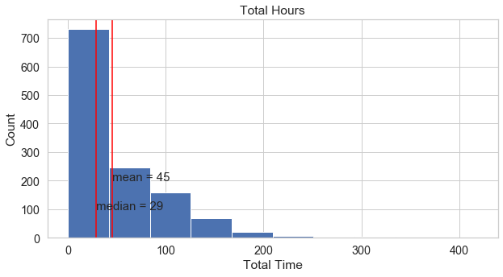
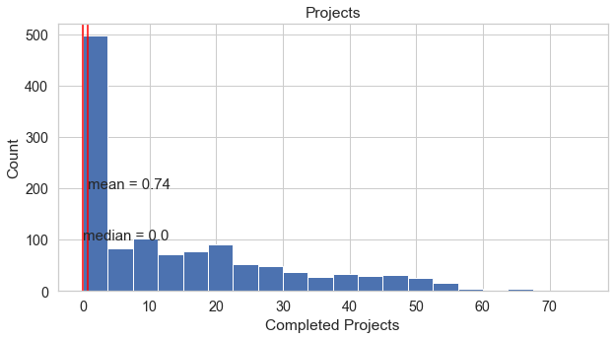
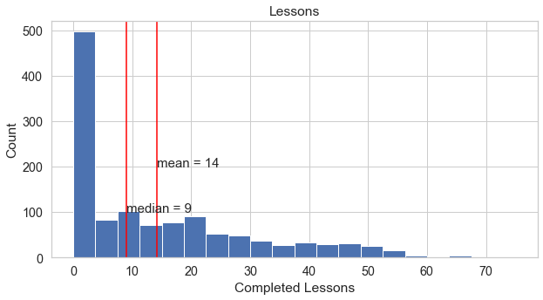
Lifetime Usage
Most people go without doing projects at all
Most people spend ~30 hours total on Udacity

Slide 7
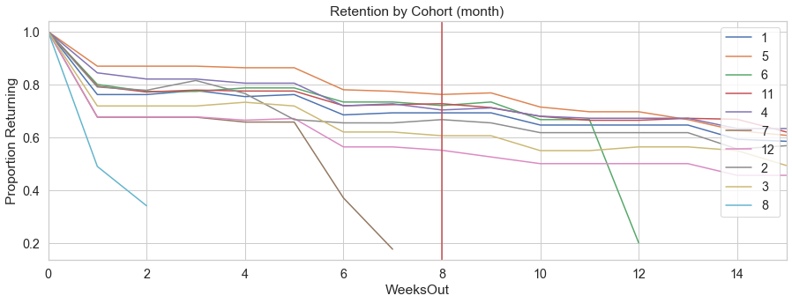
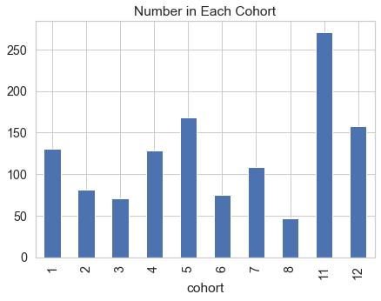
Users starting in May have the highest Retention
Users starting in December have the lowest Retention

Slide 8

Why?
Why are May users more likely to stay and December users less likely?

Slide 9
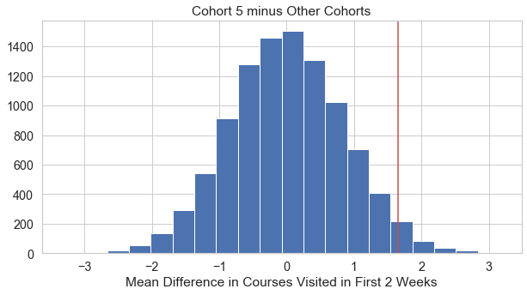
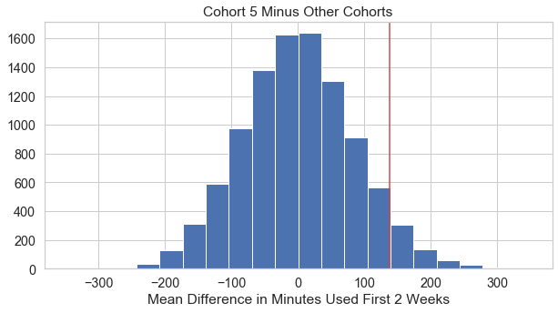

Hypothesis Testing
Statistical Significance testing between cohort 5 and everyone else
$μ_{5}$= Average number of times people in cohort 5 performed the event within the first 2 weeks.
$μ_{not5}$= Average number of times people not in cohort 5 performed the event within the first 2 weeks.
$H_{0}: μ_{5} ≤μ_{not5}$
$H_{a}: μ_{5}>μ_{not5}$

Slide 10
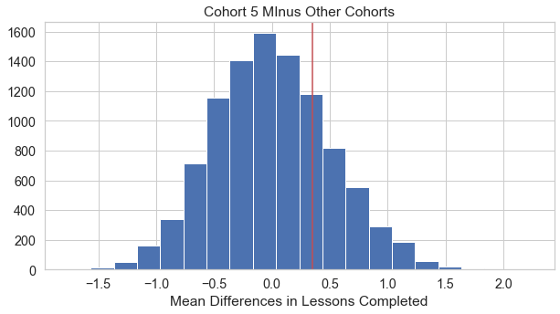
Non-Statistically Significant Example

Slide 11
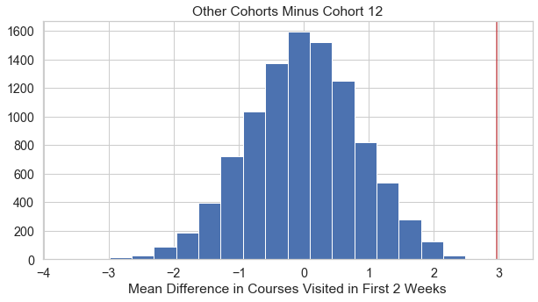
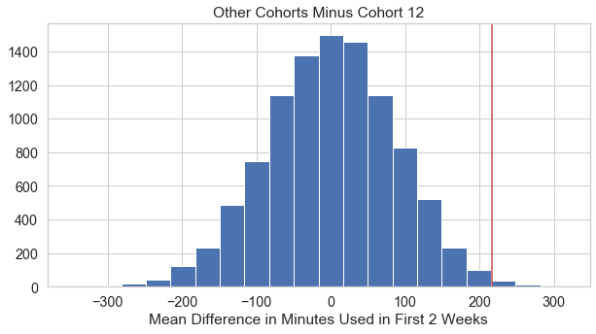
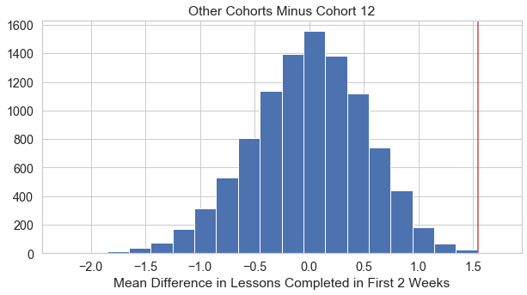
December Cohort Uses much Less
Same Hypotheses as for May

Slide 12
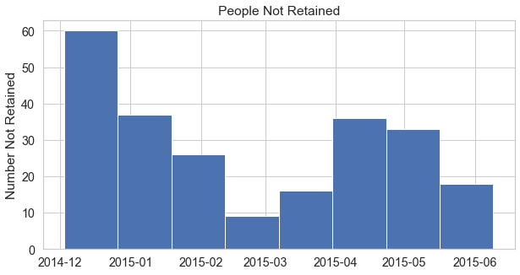
Most people Not Being Retained Started in December
Retained = 2 Months

Slide 13
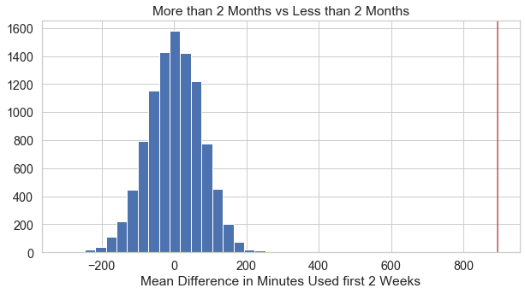
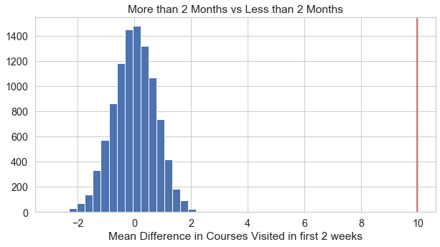
Comparing people who Stay Longer than 2 Months to those who Don’t
People staying have many more minutes and viewed more courses than others in first two weeks

Slide 14
Conclusions
People starting in May are more likely retained
Visited more courses and used for longer
People starting in December are least likely to be retained
Did everything less
Vacation time?
Those retained visited more courses and used for longer

Slide 15



Recommendations
Incentivize during the Christmas/Holiday season
Longer lasting sessions
Recommendation System for Similar Courses
More Visited Courses

Slide 16
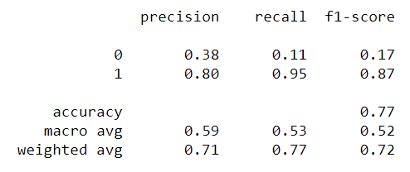
Future Projects
Predictive Analytics
Modeling
Further Breakdown
Actual Start Date
Types of courses

